Slide 1
CSS2 Spring 2021
Garrett Swan

Slide 2
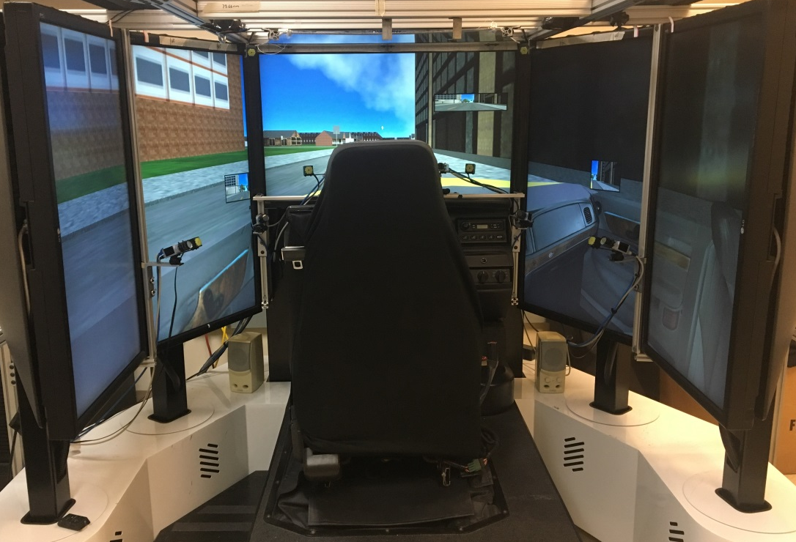
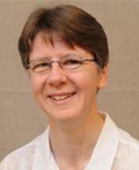
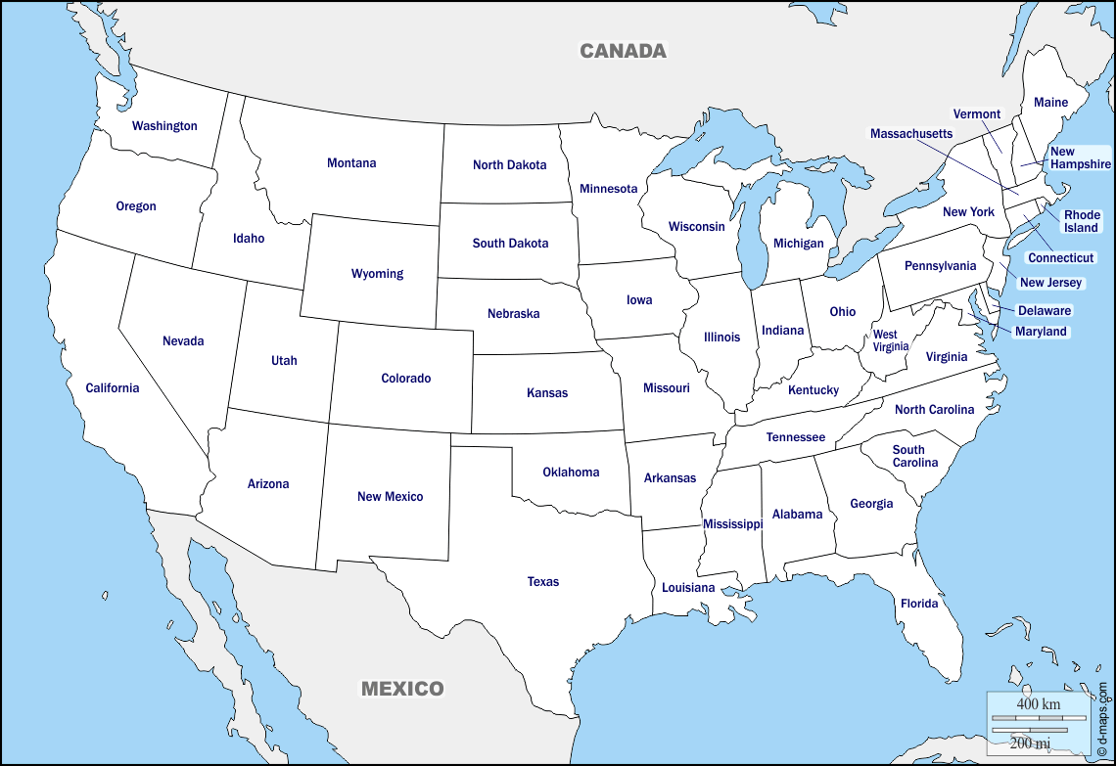
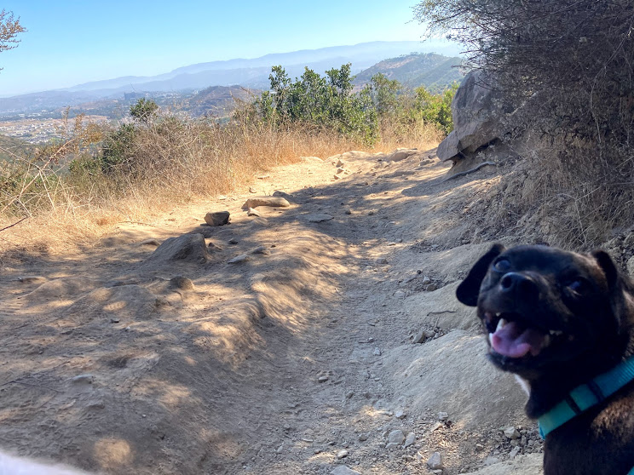
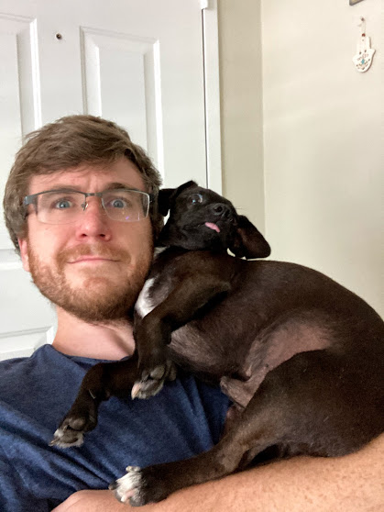
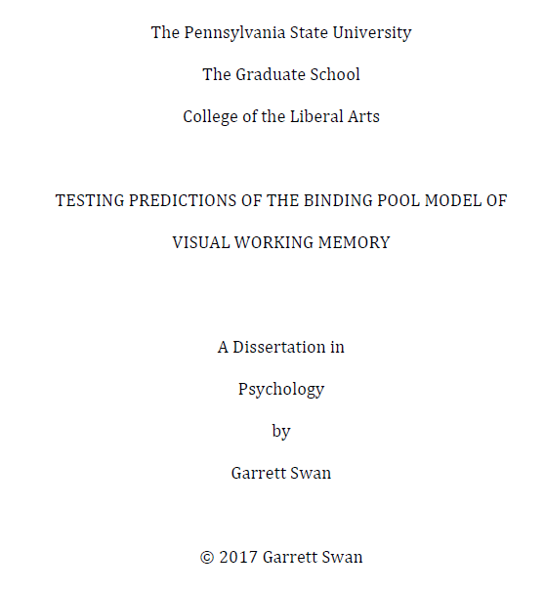
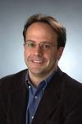
Who am I?

Slide 3
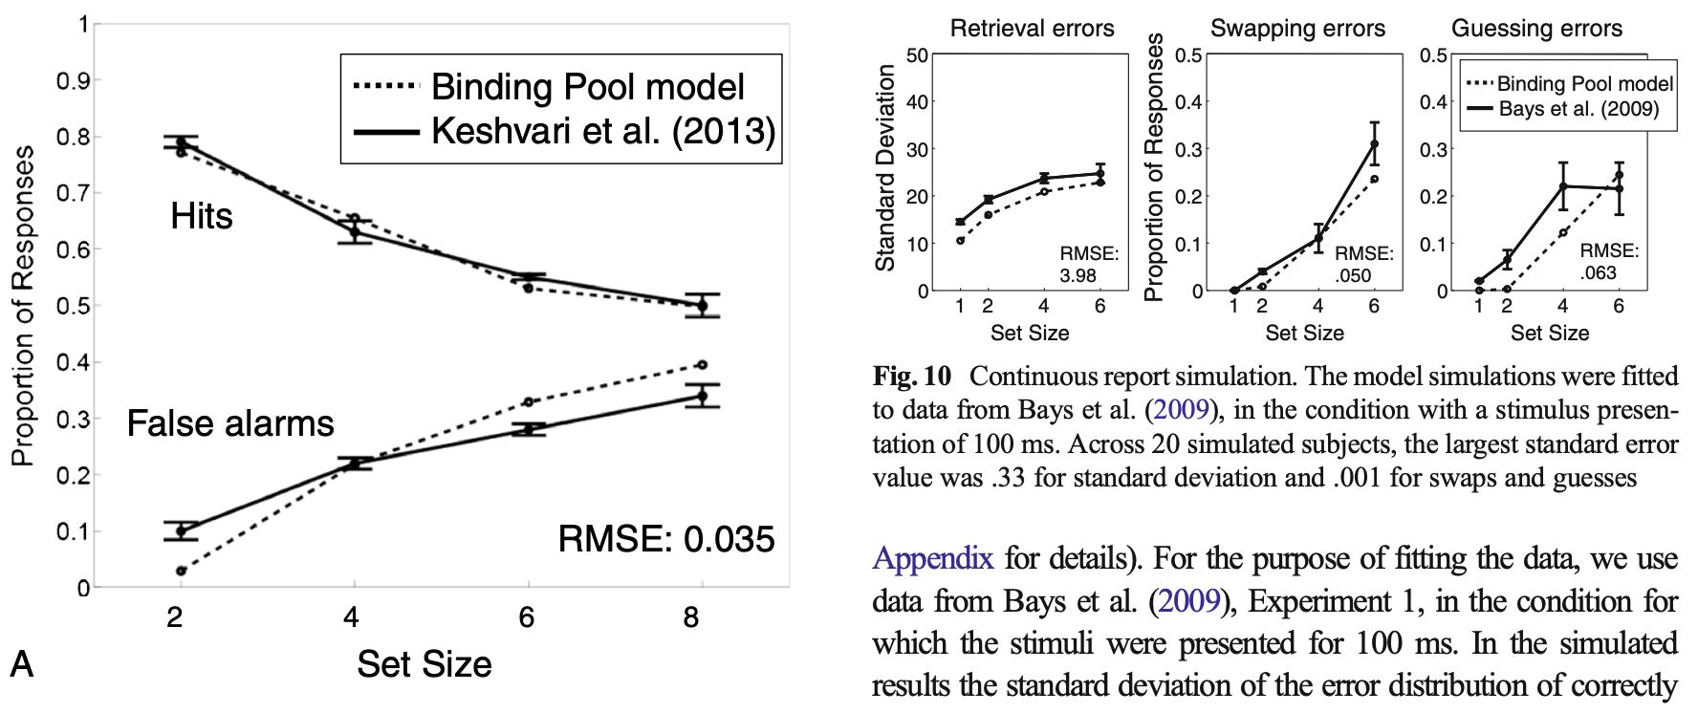
My background in research
PhD research in Cognitive Psychology:
Simulate different psychology experiments and compare our simulations to real data

Slide 4

My background in research
Schepens Eye Research Institute
How do we move our eyes when we drive to detect potential hazards?
Left scan
Right scan

Slide 5
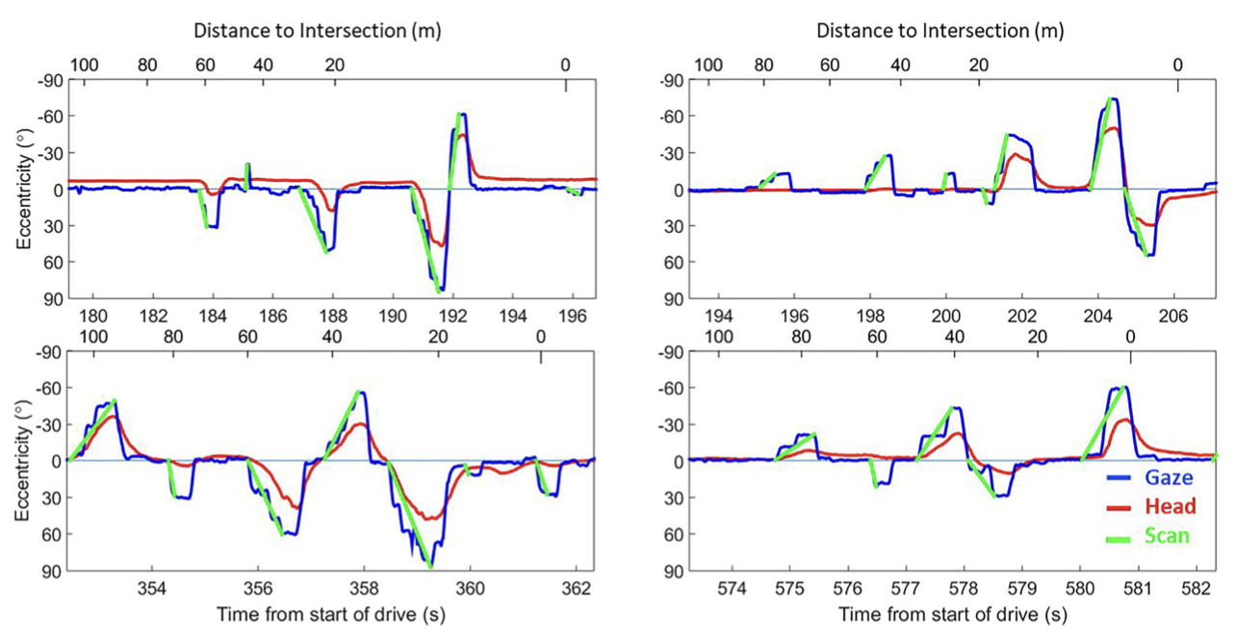
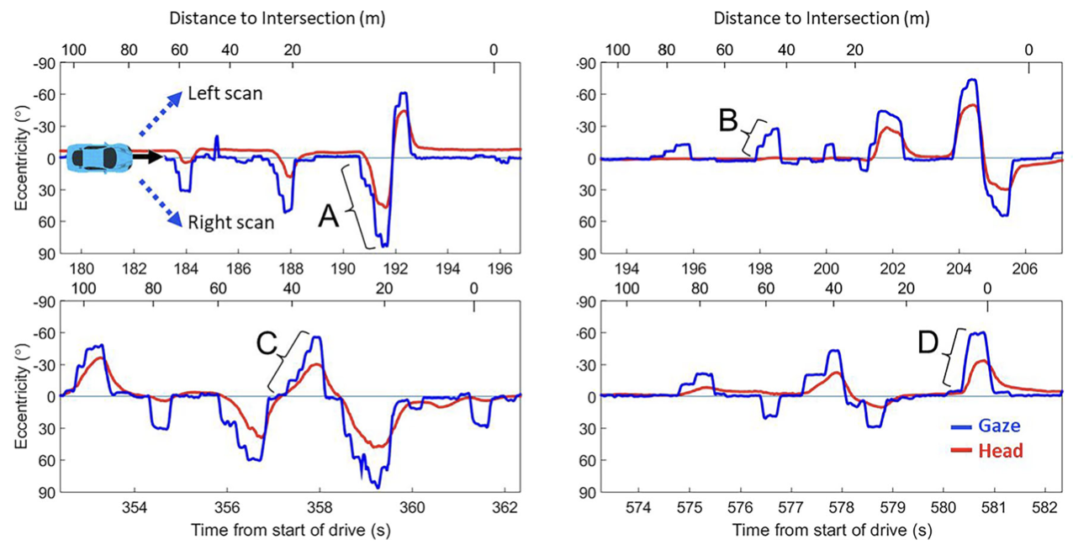
My background in research
Schepens Eye Research Institute
Develop software that automatically processes this data <- called the gaze scan algorithm

Slide 6
Who are you?

Slide 7
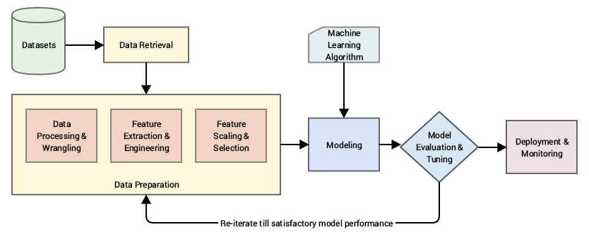
Here is the plan:
Machine learning approach

Slide 8
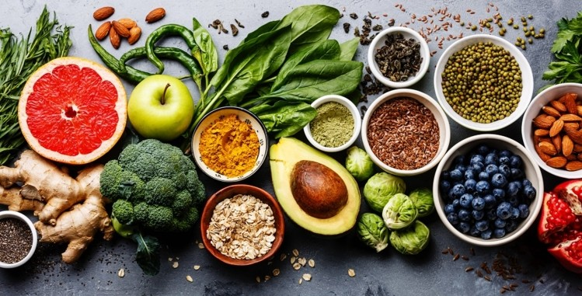
Part 1:
Interacting with data
Visualizing data
Accessing data (fake data, datasets, web scraping)

Slide 9
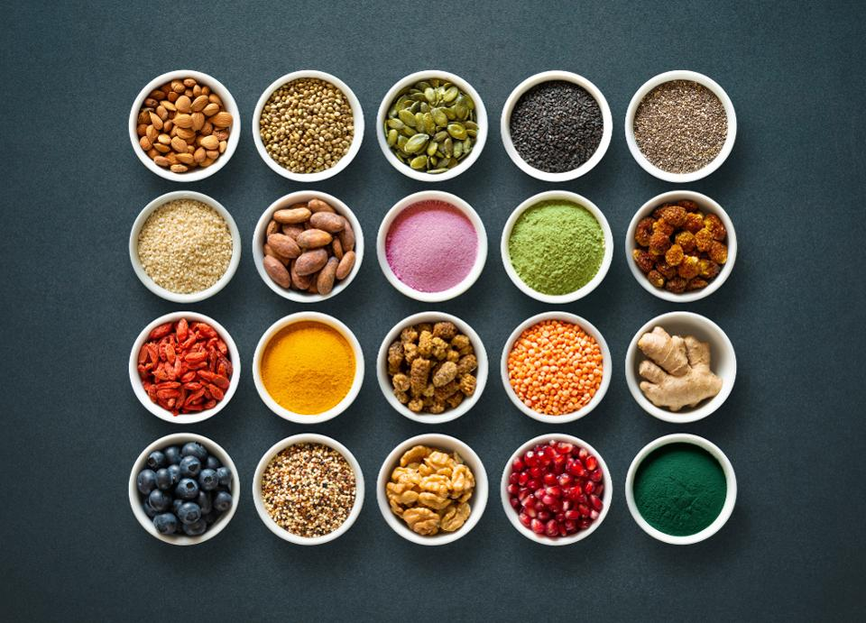
Part 1:
Interacting with data
Visualizing data
Accessing data (fake data, datasets, web scraping)
Part 2:
Preparing data
Feature engineering

Slide 10

Part 1:
Interacting with data
Visualizing data
Accessing data (fake data, datasets, web scraping)
Part 2:
Preparing data
Feature engineering
Part 3:
Understanding patterns in the data

Slide 11
Python – programming language
Numpy, Pandas, Matplotlib, Seaborn, Beautiful-soup, Scikit-Learn
These aren’t the only tools/libraries and there is a lot of overlap between these tools/libraries
Most of the fun is learning!
Google colab – its convenient
Jupyter notebook
My recommendation:
Try other Integrated Development Environments (IDE)
Download Anaconda: Sypder, Jupyter, or JupyterLab
Github
I’ll talk about this later

Slide 12
Week 1: Google colab, pandas, numpy,
Week 2: matplotlib, and seaborn
Week 3: obtaining data, basics of web scraping,
Week 4: web scraping continued, then what is feature engineering, missing data
Week 5: duplicates, outlier removal, then what is machine learning,
Week 6: linear regression
Week 7: polynomial regression, binary classification
Week 8: binary classification (decision tree, logistic regression, and support vector machine)
Week 9: Cross validation, k-means clustering,
Week 10: PCA, review course

Slide 13
By the end of the session, you should
Basic understanding of data science/computational social science
Visualize
Clean and process
Analyze (model)
Programming
Good habits/intuitions
Additional syntax
Debugging

Slide 14
Syllabus

Slide 15
Instructor: Garrett Swan (gswan@ucsd.edu)
Office Hours: By appt and Tuesday 9:00am to 10:00am
TA: Sunyoung Park (supark@ucsd.edu)
Office Hours: By appt and Thursday 2:00pm to 3:00pm
UGIA: Brendon Halm (bhahm@ucsd.edu)
Office Hours: By appt and Friday 5:00pm to 6:00pm

Slide 16
Lecture time: Monday and Wednesday 5:00pm to 6:20pm
Each lecture will consist of coding and you are encouraged to follow along
The initial plan is that each lecture will take place during regular course time over Zoom
The lectures are non-mandatory and will be recorded and uploaded online for you to access throughout the semester

Slide 17
Section A01: Wednesday 2:00pm to 2:50pm
Section A02: Wednesday 3:00pm to 3:50pm
In sections you can ask questions about (1) stuff we covered in class, (2) the previous problem sets, and (3) the upcoming problem sets

Slide 18
Material and Textbook
Lecture material (videos and code sheets) will be provided on Canvas
There is no required textbook for this course. However, there are many intro books out there that you might find helpful, such as “Python for Data Analysis: Data Wrangling with Pandas, NumPy, and IPython” by Wes McKinney and “Python Data Science Handbook: Essential Tools for Working with Data” by Jake VanderPlas

Slide 19
Assignments:
Short Quizzes
Every week, there will be a quiz with multiple-choice questions on material discussed that week
Discussion board posts
There will be a bi-weekly prompt on Canvas whereby you submit and respond on the Canvas discussion board.
Problem sets
Every week, there will be a problem-set using material discussed that week.
Problem sets will typically have bonus points for completing the assignment in a more challenging way

Slide 20
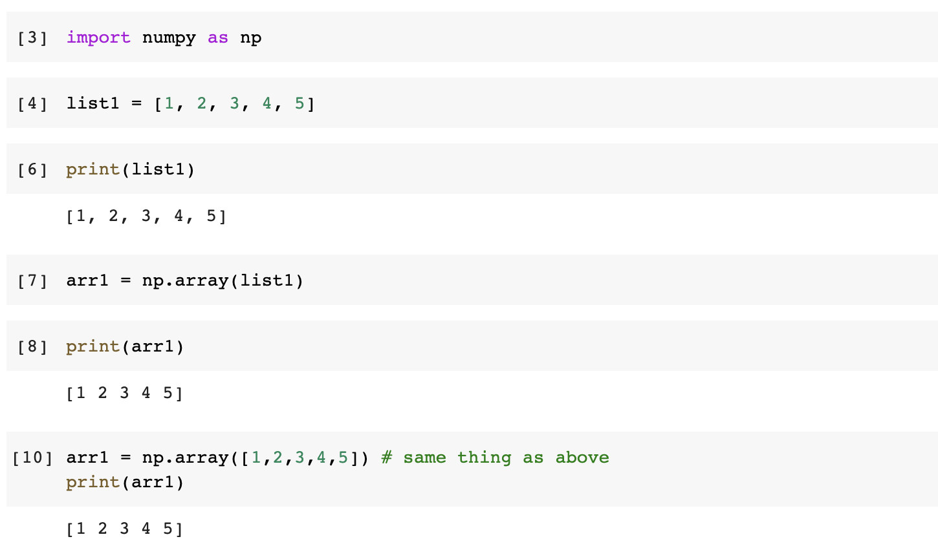
Problem set template will be different from how we code in class:
In class, we will typically code like this:

Slide 21
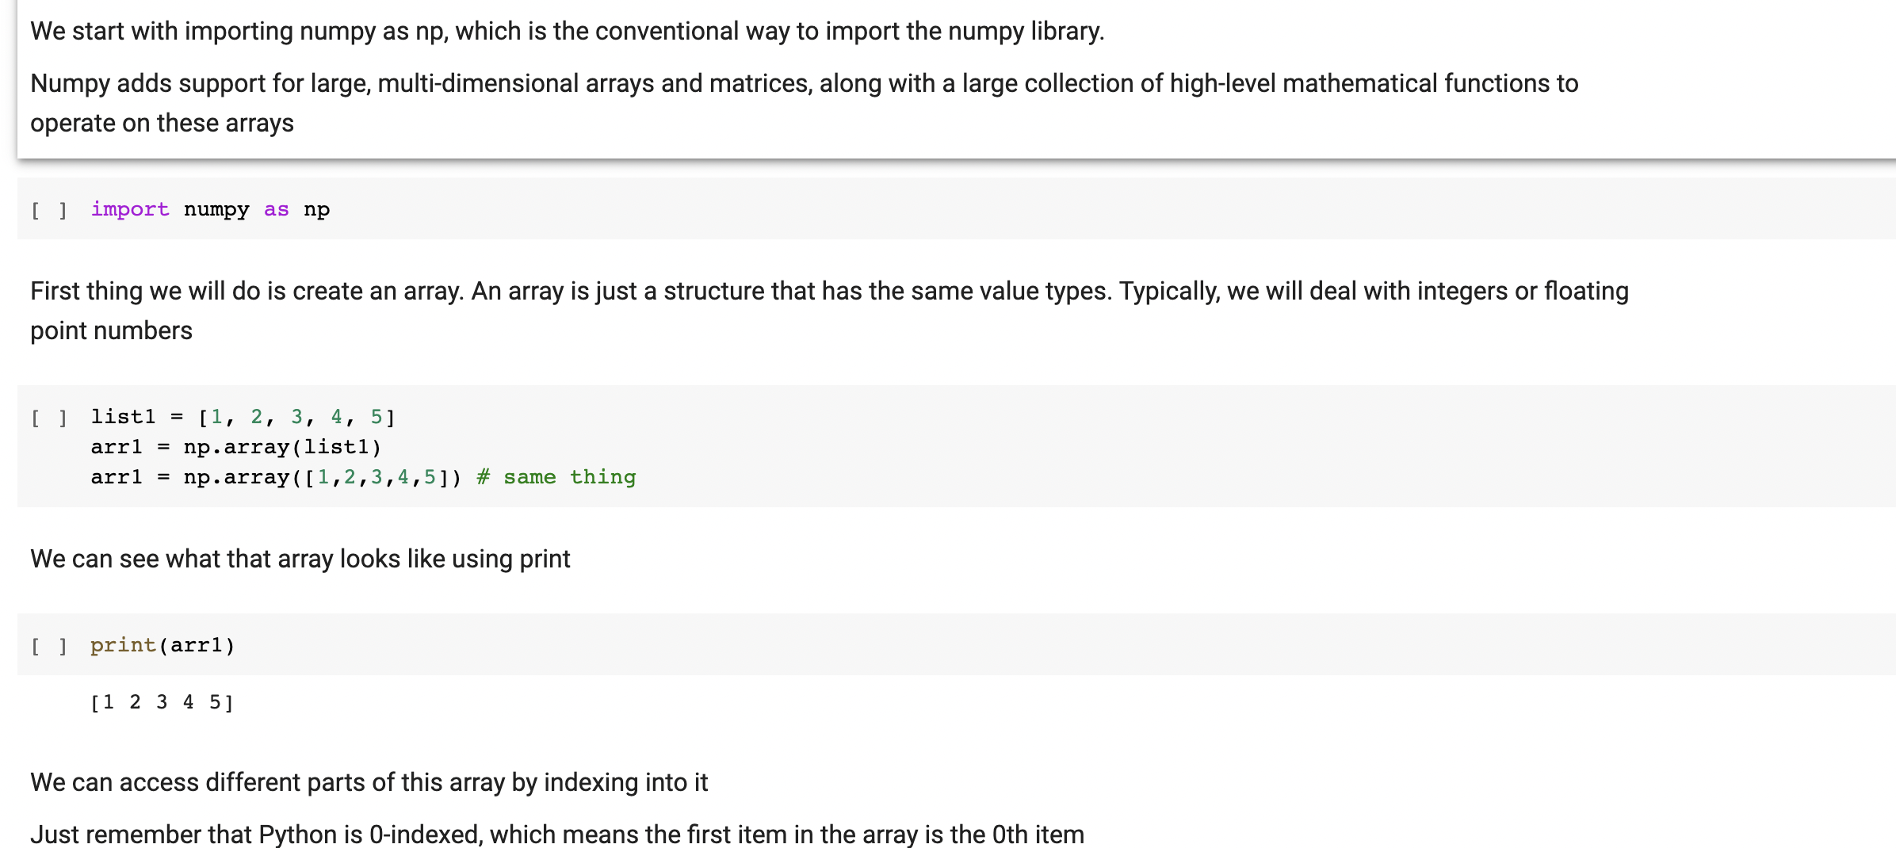
In my notes that I’ll upload after class, you will see comments and other text

Slide 22
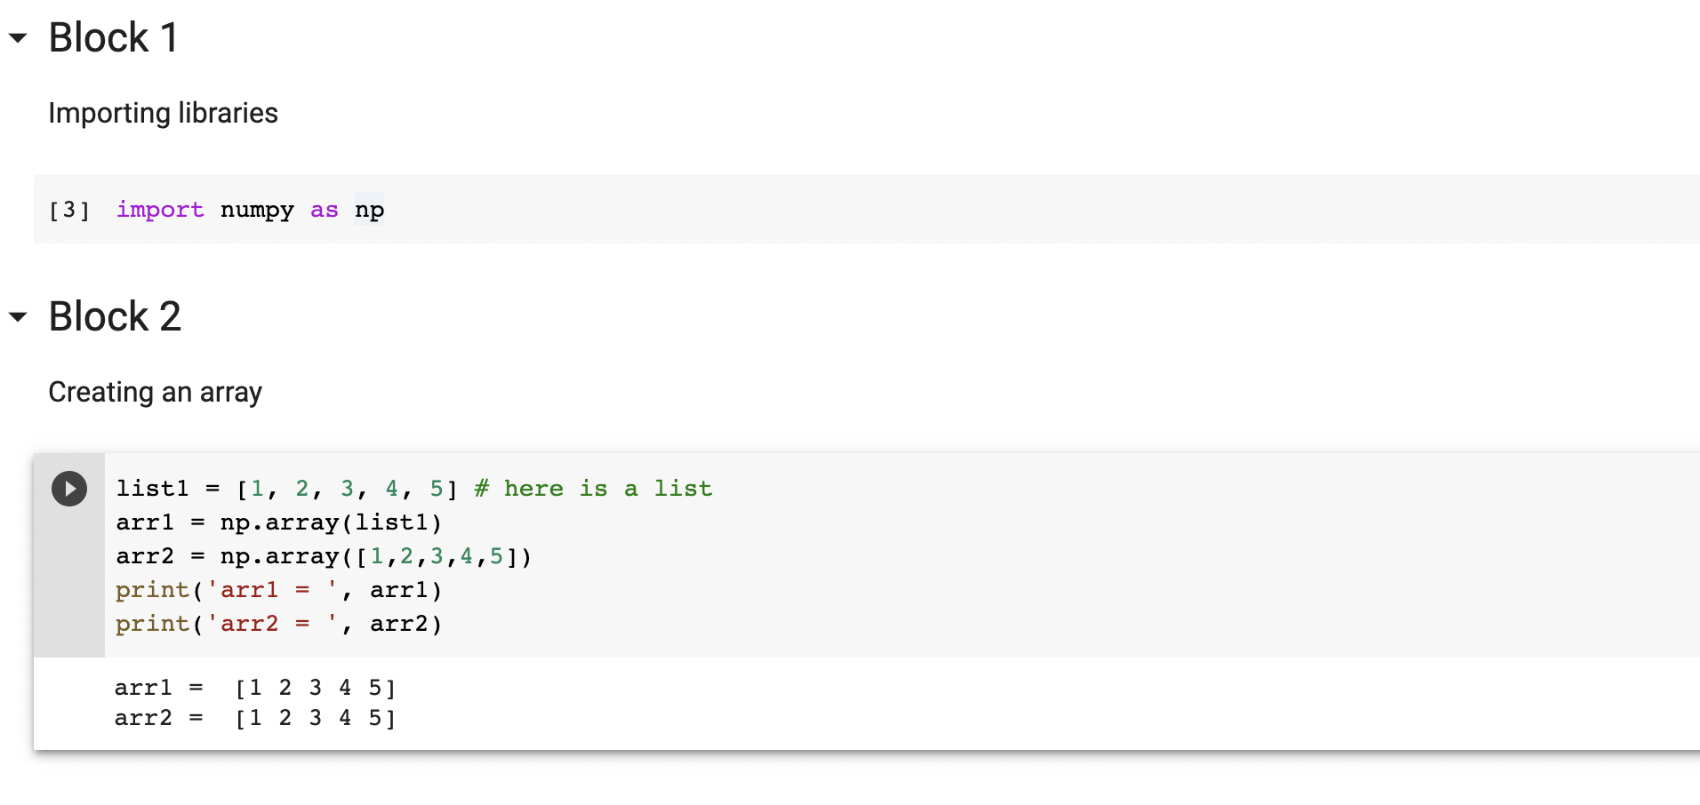
Final submissions should look more like this:

Slide 23
Assignments:
Final Project
Instead of a final exam you will have a final project that will require you to generate code to extract, visualize, engineer, and analyze data from potentially 1 of 5 datasets. More details will be provided during 2nd week of class. The final project will be worth 50 points.

Slide 24
Individually
In total
discussion board | 1.28%
quizzes | 2.56%
problem sets | 5.13%
final project | 25.64%
discussion board | 5.13%
quizzes | 23.08%
problem sets | 46.15%
final project | 25.64%
Extra credit:
CAPEs for submission percentage
Problem sets will have extra credit
Github commits will result in extra credit

Slide 25
For help, you can ask questions in class, in office hours, and especially during the sections
There is also a course Piazza and discord
See the announcement from Brendon and the syllabus for details

Slide 26
General debugging advice
Like learning any skill, practice makes perfect.
Double check the spelling/syntax
Print and check the variables
If it’s a function or operation, check the help menu to see that you are using the correct syntax
Create a new workbook, copy and paste the variables and code specifically related to the error, then try it
If the error is still occurring, try googling the error message
If there is no obvious solution on google, try rewording the problem you are having
If the problem is still occurring, email your TA/UGIA
If the problem is still occurring, contact your instructor

Slide 27
Academic Integrity
From UCSD Academic Integrity office
"Integrity of scholarship is essential for an academic community. The University expects that both faculty and students will honor this principle and in so doing protect the validity of University intellectual work. For students, this means that all academic work will be done by the individual to whom it is assigned, without unauthorized aid of any kind.”
Please read the full UCSD policy
This course will also make use of online quizzes and exams via Google Forms. This means that each of you will be sent an email and will take quizzes/exams online with your user_name@ucsd.edu email linked to your grade. Taking a quiz or exam logged in as another student will be treated as a violation and you will be referred for disciplinary action. Similarly, emailing with or otherwise communicating with other students or anyone else during a quiz or exam will be treated as a violation and also referred for disciplinary action.

Slide 28
Class Conduct
I expect respect and consideration for both your classmates and myself. Please contact me if you feel as if any problems arise were you feel as if the classroom is no longer an exclusive environment.

Slide 30
Last thing:
Github extra credit
Create a repository for this class
Have at least 9 commits by the end of the quarter
For a total of 4 bonus points
Note, if you have a different repository, that is fine too
Google drive/dropbox don’t really count as a repository here

